Slide 1

The importance of storytelling in information visualisation
Data Visualisation

Slide 2
Overview
Question + Visual Data + Context = Story
Steps for creating effective Visualisation
Most commonly used Visual representations
Case study

Slide 3
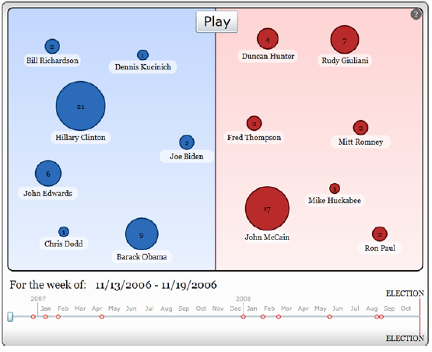
Question + Visual Data + Context = Story

Slide 4
Steps for creating effective Visualisation by Matthias Shapiro
Formulate the question
    Where, when, how much, how often?
Gather the data
    http://www.data.gov
    http://www.census.gov
    http://developer.nytimes.com
Apply a visual representation
  Lets take a look at the most commonly used visual representations

Slide 5
Most commonly used Visual representations
Size
Colour
Location
Networks
Time
Using multiple visual presentation methods

Slide 6
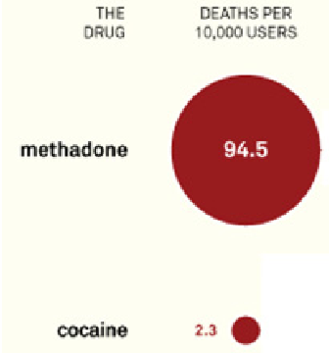
Size vs Size
Quickly judge the difference between two objects
Which recreational drug causes the most deaths (methadone or cocaine)?
  Methadone kills more people in the UK than cocaine

Slide 7
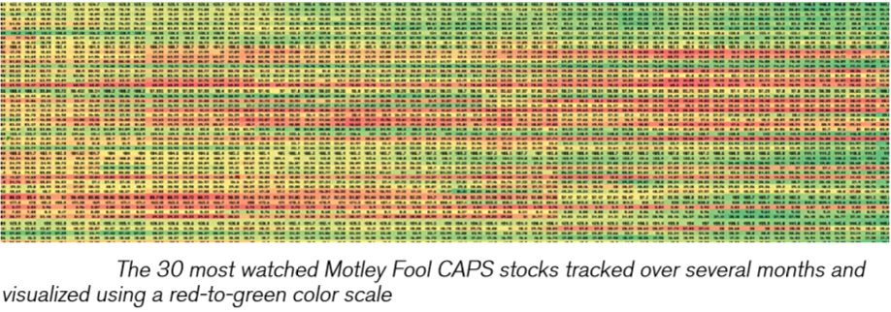
Colour
Great for enormous sets of data

Slide 8
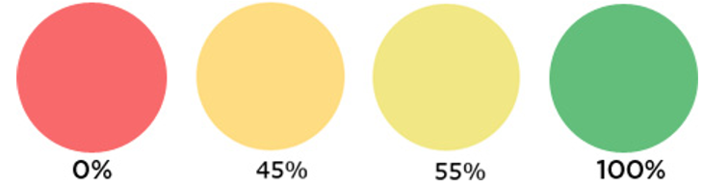
Colour
Does it work when there are small differences?

Slide 9
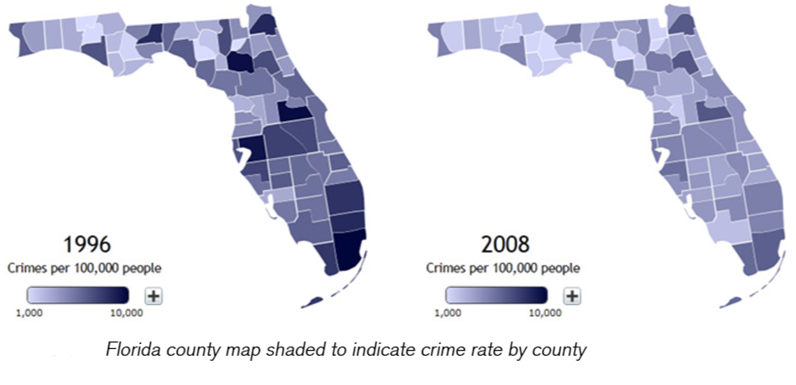
Location
Attaches data to map

Slide 10
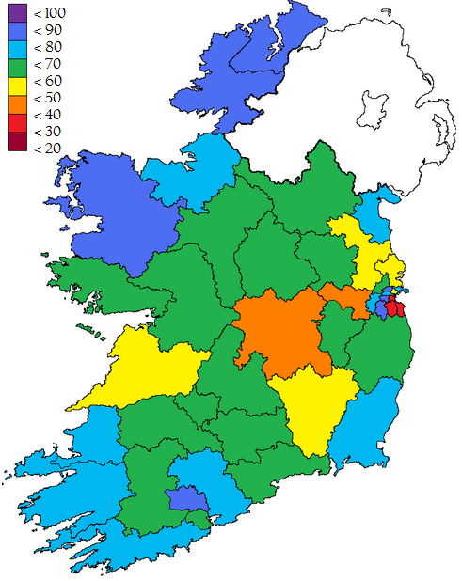
Location
Enhances message especially if you can relate to the area

Slide 11
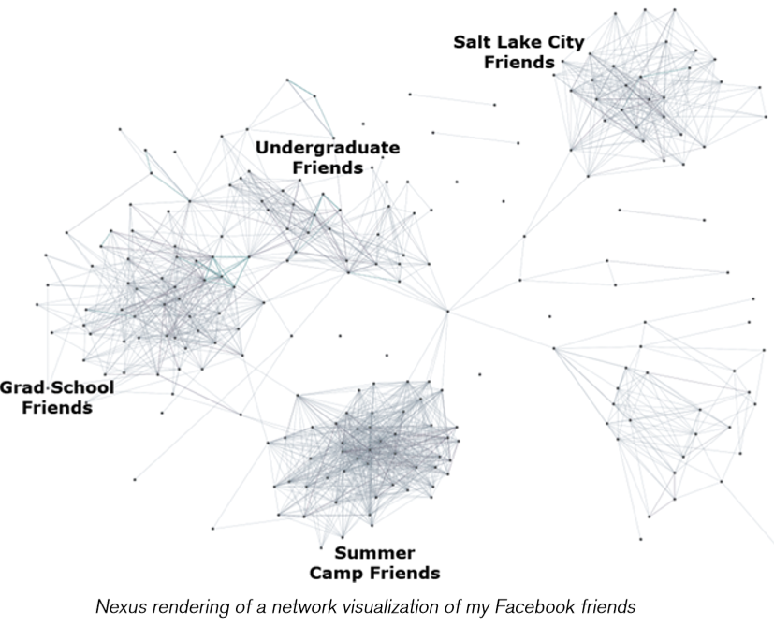
Networks
Shows binary connections between data points

Slide 12
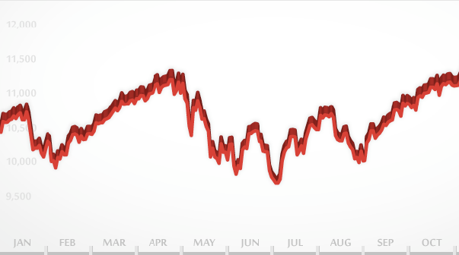
Time
Use timeline to show data change over that period
Twitter chatter visualised during sports event
  http://www.nytimes.com/interactive/2009/02/02/sports/20090202_superbowl_twitter.html?_r=0

Slide 13
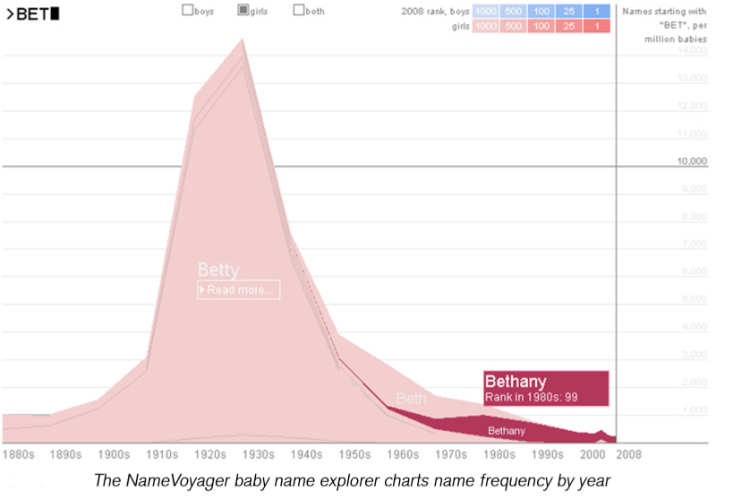
Using multiple visual presentation methods
Many excellent visualisations use more than one of these methods
What are the two main visualisation methods used here?
http://www.babynamewizard.com/voyager#prefix=ben&sw=both&exact=false

Slide 14
References
Matthias Shapiro (2011). Beautiful Visualization (edited by Julie Steele & Noah Iliinsky). 2nd ed. Canada: O'Reilly Media. p15-36 (The importance of Storytelling in Information Visualisation)

Slide 15
Case study
Now that we’ve covered the basics of information visualization in a general manner, let’s walk through the process of building a visualization. We’ll create a static visualisation, commonly referred to as an infographic.
In order to replicate the process as closely as possible, we will walk through the discovery process in the order in which it actually happened rather than following the “Question-Data-Presentation” method described earlier.
Excel and Photoshop are used during this process

